Slide 1
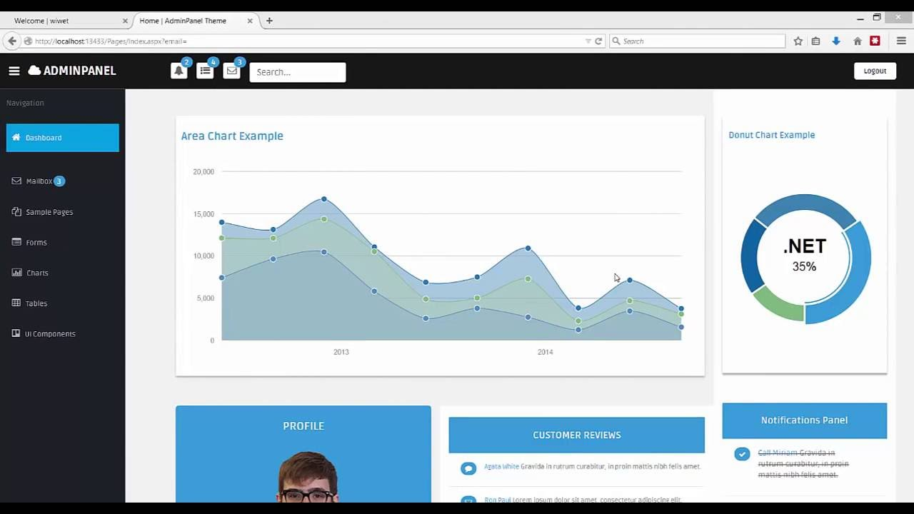
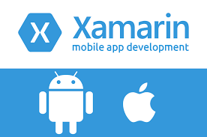
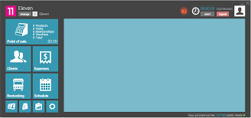
C# is general-purpose programing language use for desktop, mobile and web application development
Xamarin
WinForms and WPF
Asp

Slide 2
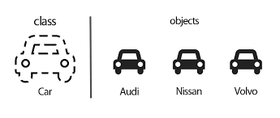
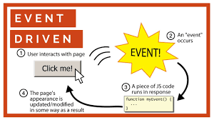
C# multi-paradigm programing language (OOP, event-driven …)
OOP
Event driven

Slide 3
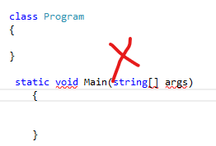
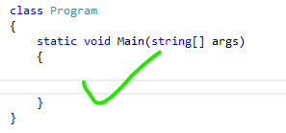
C# is class based
No
Yes

Slide 4


C# has been considered as a strongly typed language
Strong type
Dynamic type

Slide 5

Developed around 2000 by Microsoft as part from .NET

Slide 6


